Slide 1
Making complex decisions
BY:
SHIVIKA SODHI

Slide 2
INTRODUCTION
Computational issues involved in making decisions in a stochastic (randomly determined) environment is addressed here.
Agent’s utility depends on a sequence of decisions rather than one-shot/episodic decisions.

Slide 3
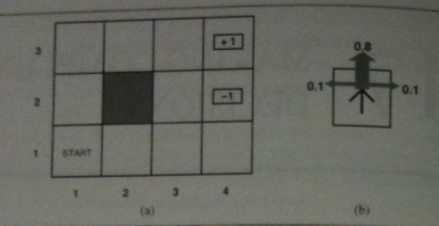
Sequential decision problems
Agent is in 4x3 environment. Must choose an action at each step. Interaction with environment terminates when it reaches goal state (+1 / -1)
Actions(s)= A(s) = the actions in every state are Up, Dawn, Left, and Right. Assume: environment is fully observable
The "intended" outcome occurs with probability 0.8, but with probability 0.2 the agent moves at right angles to the intended direction. A collision with a wall results in no movement. The two terminal states have reward +1 and -1, respectively, and all other states have a reward of -0.04.

Slide 4
Sequential decision problems
Solution for a deterministic env. would be easy: [Up, Up, Right, Right]
The outcome is stochastic → P(s’|s, a) , denotes the probability of reaching state s' if action a is done in state s.
Transition is Markovian: probability of reaching state s’ from s depends only on s, not on the history of earlier states
In each state s, agent receives a reward R(s). Utility is sum of rewards. Ex. If the agent reaches +1 state after 10 steps, its total utility will be 0.6 (1 - 0.4)

Slide 5
Sequential decision problems
Markov Decision Process: A sequential decision problem for a fully observable, stochastic environment with a Markovian transition model and additive rewards I called a MDP.
Policy (π): A solution that specifies what an agent should do for any state that it might reach. π (s)- action recommended by the policy for state s. -> Quality of a policy is measured by the expected utility of the possible environment histories generated by that policy. -> An optimal policy π(*), is a policy that yields the highest expected utility. -> Given π(*), the agent decides what to do next by consulting its current percept, which tells it the current state s and then executing the action π*(s). (policy is the description of a simple reflex agent, computed from the information used for a utility-based agent )

Slide 6
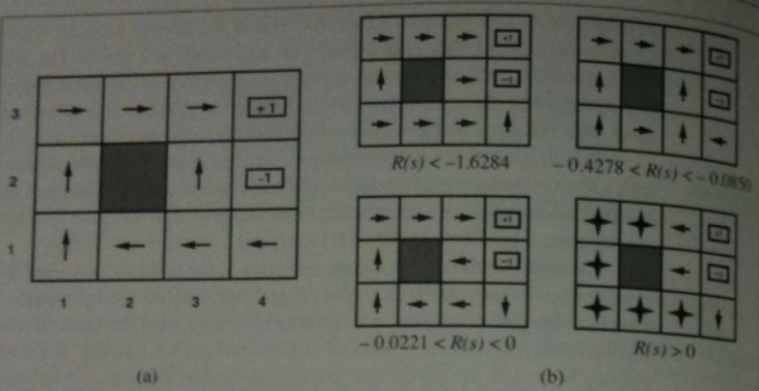
Sequential decision problems
For nonterminal states, the balance of risk and reward change depending on the value of R(s).
R(s)<-1.56 (Agent heads for the nearest exit)
-0.42<R(s)<-0.856 (Agent takes shortest route, risking -1)
-0.02<R(s)<0 (No risks at all)
R(s)>0 (Agent avoids both exits)
Optimal Policy

Slide 7
Utilities over Time
Is there a finite or infinite horizon for decision making?
Finite horizon: there is a fixed time N after which nothing matters—the game is over. Optimal policy for a finite horizon is nonstationary
Infinite horizon: no fixed time, thus the optimal action depends only on the current state, and the optimal policy is stationary.
Policies for infinite-horizon are simpler than those for finite-horizon.
Multiattribute utility theory: Each state can be viewed as an attribute of state sequence [S₀ S₁ S₂ S₃ S₄ …]

Slide 8
Utilities over Time
Assumption: agent's preferences between state sequences are stationary.
2 coherent ways to assign utilities to sequences, Under stationarity: Additive rewards (special case of discount awards when Y=1) U_{h}([S₀ S₁ S₂ S₃ …] = R(S₀) + R(S₁) + … Discounted rewards (discount factor describes the preference of an agent for current rewards over future rewards.) [γ, preference of an agent for current rewards over future rewards, is between 0 n 1] U_{h}([S₀ S₁ S₂ S₃ …] = R(S₀) + γ R(S₁) + γ ²R(S₂) …
γ → 0, rewards in future seem insignificant. (1/γ-1 : Interest rate)

Slide 9
Utilities over Time
Solution for infinite sequences ➔
With discounted rewards, the utility of an infinite sequence is finite.
If the environment contains terminal states and if the agent is guaranteed to get to one eventually, then we will never need to compare infinite sequences. A policy that is guaranteed to reach a terminal state is called a proper policy.
Infinite sequences can be compared in terms of the average reward obtained per time step.

Slide 10
Optimal policies and the utilities of states
Utility of a given state sequence is the sum of the discounted rewards obtained during the sequence.
Initial state of agent: s=s₀; State at time t when executing π : s_{t}
π*_{s} = argmax U^{π}(s) (policies with higher expected utilities)
π*_{s}: recommends an action for every state; its an optimal policy when s is the starting state
For discounted utilities with infinite horizons, optimal policy is independent of the starting state

Slide 11
VALUE ITERATION: The Bellman equation for utilities
Value Iteration: Calculate utility of each state and use it to select an optimal action in each state.
The utility of a state is the immediate reward for that state plus the expected discounted utility of the next state, assuming that the agent chooses the optimal action. [U(s) = R(s) + γ max Σ(P(s’|s,a)U(s’))] -> Bellman equation

Slide 12
The value iteration algorithm
Bellman equation is the basis of the value iteration algorithm for solving MDPs.
For n possible states, there are n Bellman equations.
N equations contain n unknowns – utilities of the states.
Equations are non linear because the “max” operator is not a linear operator.
These equations are solved with iteration, calculate right-side, plug it to the left-side, updating the utility of each state through it’s neighbor. Ui(s): utility value of state s at ith iteration. Iteration step is called Bellman Update: Ui+1(s).

Slide 13
The value iteration algorithm
The update is assumed to be applied simultaneously to all states at each iteration.
If we apply Bellman update often, we might reach equilibrium, in which final utility values must be solutions to Bellman equation.
Value iteration can be applied to 4x3 world discussed above. Starting with the initial value of 0, the utilities evolve.
This algorithm can also be “propogating information through the state space by means of local updates”

Slide 14
Convergence of value iteration
Value iteration converges to Bellman equations(unique set of soln.)
Contraction: -> produces 2 output values that are “closer together” by const. factor than original inpus, when applied to 2 diff inputs. -> has only 1 fixed point -> func applied to any arg, value must reach closer to fixed point
Bellman Update: Ui+1 <- BUi. → Ui denotes the vector of utilities for all states at ith iteration. → B, update the utility of every state.

Slide 15
POLICY ITERATION

Slide 16
PARTIALLY OBSERVABLE MDPS

Slide 17
DECISIONS WITH MULTIPLE AGENTS: Game Theory

